Slide 1
Team Hotwheels Self-Driving Car
Alexander Garcia
Kolton Speer

Slide 2
Motivation
Roughly 100 people die in car accidents every day in America alone
Self Driving cars have the potential to help cut emissions
Increased mobility for people who can’t drive
Children and Seniors
Handicapped
Notes:
Alexander
Reduce accidents with detection. Distracted driving.
Another way to reduce emissions from autonomous vehicles is to enable more efficient driving patterns. By limiting human interaction with driving, it would reduce repeated braking and acceleration and even allow vehicles to travel closer together which is known to improve aerodynamics. Vehicle-to-vehicle communication. (sponsored DoT)
Children don’t have to get in a Uber or Lyft with a stranger danger

Slide 3

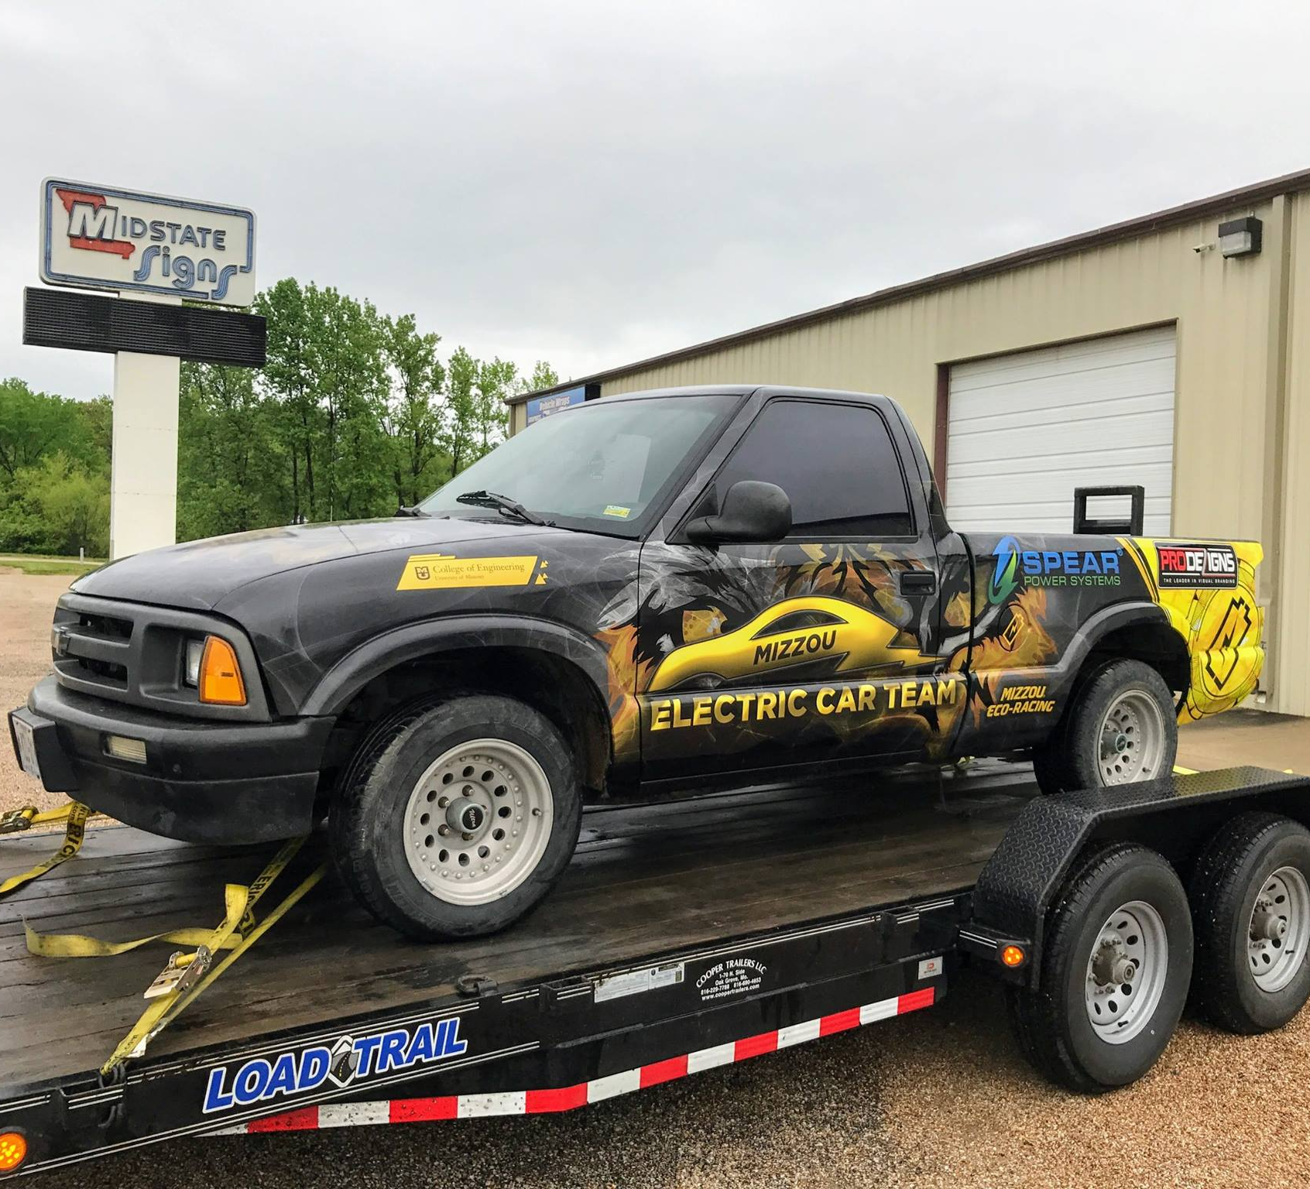

The Platform
Mizzou Eco Racing
Electric Chevy S-10 Pickup
Small
Has a bed
Notes:
Kolton
Project is made possible through Mizzou Eco Racing. Kindly allowed us to use electric pickup. Car is really good for this project because it’s small (maneuverable) but also has a bed for equipment.
Battery box is 120 Volts, so may be able to power equipment from box.

Slide 4
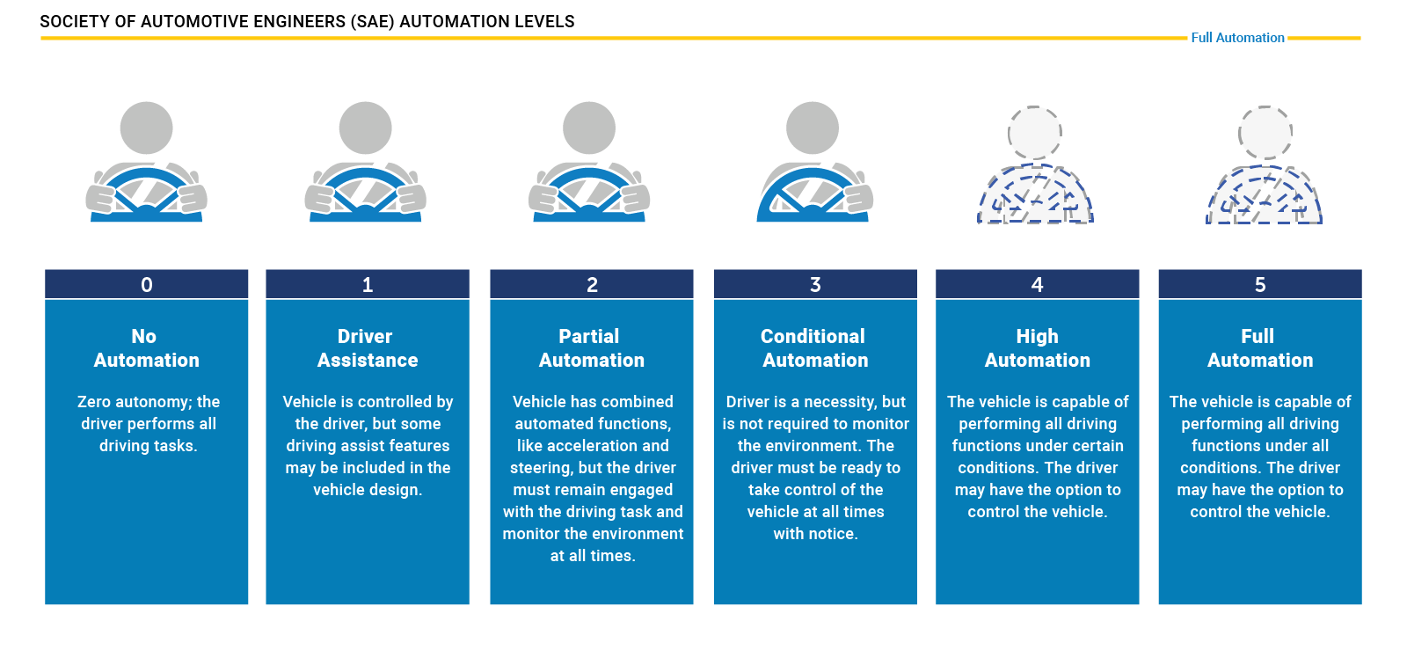
SAE Levels of Autonomy
Notes:
Shooting for level 2 automation. Bleeding edge is 3.5ish. 80% of the work is getting up to 3. 4 and 5 constitute a much harder challenge.

Slide 5
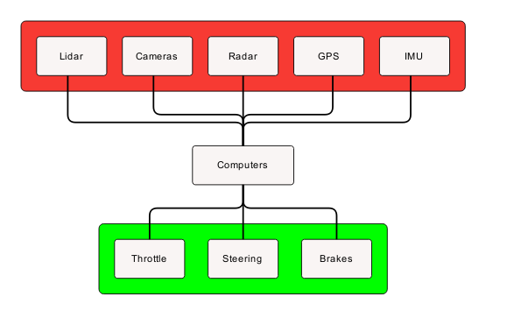

Implementation Overview
Perception
Cameras, Lidar/Radar, Positioning
Control
Computers, ROS
Action
Steering, Brakes, Throttle
Notes:
Alex
This is just general flow of things. In depth info provided in the upcoming slides.

Slide 6
Perception
Cameras
Object detection and path planning
Lidar
Object detection and distance detection
Radar
Emergency braking
GPS/IMU
Path planning and localization
Notes:
Alex
Lidar – Light detection and ranging – shoots light and measures the time it takes for it to return. Burst out is call PULSE and burst back in is called RETURN. Accurate within +- 2cm. Cheap models up to 60m with expensive units at 200m.
-- Primary ‘vision unit’
-- provide 3D map
IMU- Inertial measurement Unit – Motion and position of vehicle
GPS- Global positioning system – receives signals from low orbit satellites needs IMU as accessory because GPS can be blocked or interfered with by canyons, tunnels etc..
Cameras are great but computationally expensive.
Radar – can determine velocity of a moving better than LIDAR. Also works better in inclement conditions.

Slide 7
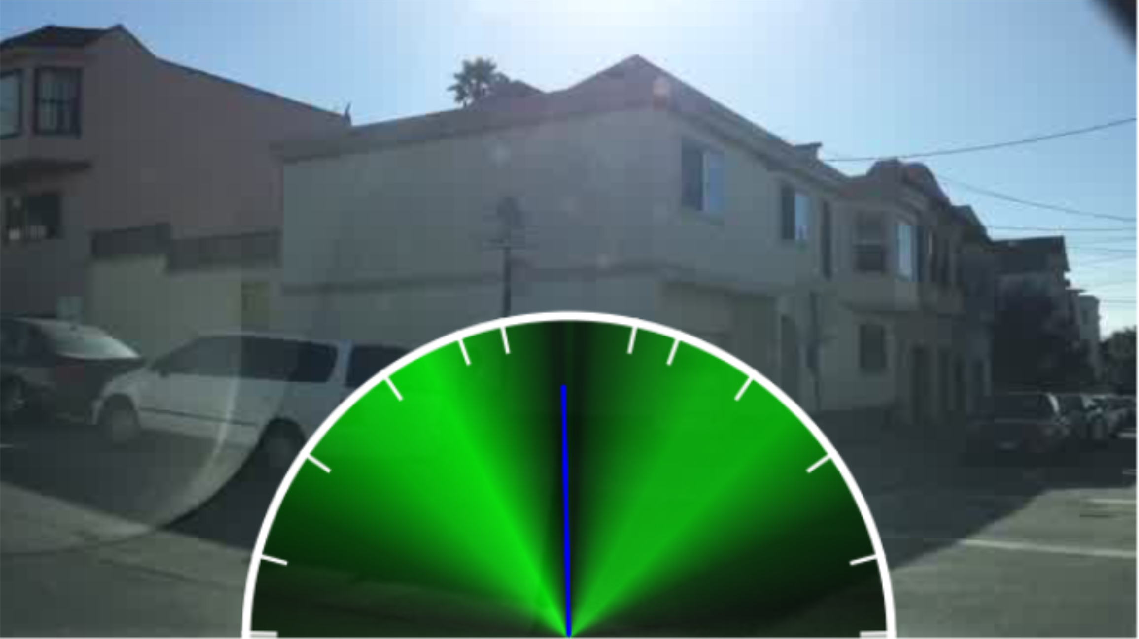
Path Planning
GPS mapping for general path
Cameras and deep learning model to find drivable area along that general path
Berkley Deep Drive dataset
End to End model based on Berkley and Nvidia models
Model makes a decision, we adjust with other information
Notes:
Kolton
We will use GPS to find a general path, and then use neural network model to predict drive able area along that path. Plan to replicate research from Berkley and Nvidia, use deep learning to find drive able area within our field of view. This research leads us to try CNN stacked on LSTM. Model outputs a steering angle bin. Correct with other information if necessary. Training with data from Berkley deep drive dataset. Over 1100 hours of driving video across diverse situations (night, day, city, highway) with steering angle, gps, IMU data. Also includes over 100,000 images with annotated road objects (signs, lights, vehicles).

Slide 8
Software Stack
Python 3.5, C, C++
Tensorflow
Neural Network library from Google
CUDA
Parallel computing library from Nvidia
Used in training, but most likely will not be used on board
OpenCV
Open source Computer Vision library
Robot Operating System
Asynchronous message passing
Notes:
Kolton
Our code will be written predominantly in Python 3.5 with some C/C++. Languages chosen for speed and ease of development. Spew about python. Will build neural networks using Tensorflow. Will use CUDA to speed up the training process, but will most likely not be used on board. OpenCV for processing raw images from cameras. We will also use ROS to facilitate message passing between all of our services.

Slide 9
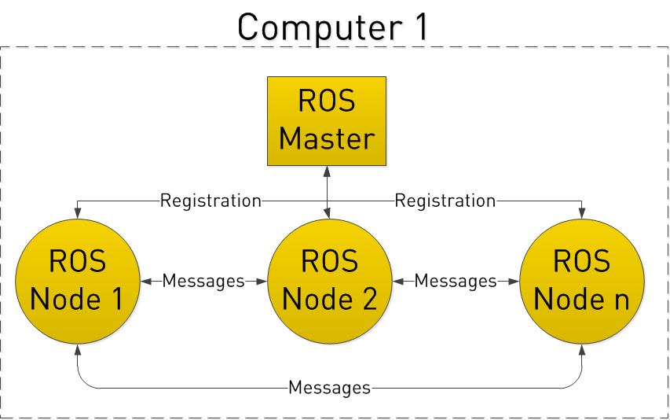

Control
Robot Operating System
Publisher subscriber model
Node for each sensor and perception service
Computers
2 or 3 computers onboard depending on sensor load
24 GB of ram
2.9GHz i7 processor
Solid State Hard drive
Training models on High Performance Computing cluster
Models are slow to train, but fast at prediction time
Notes:
Alex
Dell Optiplex 5050 Micro
Heat dissipation, vibration, environment
Robot Operating System – set of software libraries written in C++ and Python. Technically middleware.

Slide 10
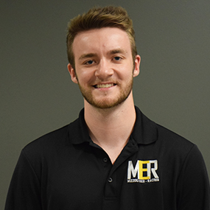
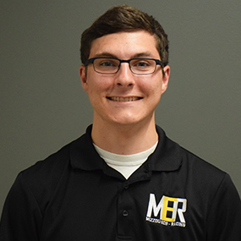
Action
Actuators on steering column, throttle, and brakes
Actuation systems designed by mechanical engineering students
Kyle Messick
Teddy Perkins
Notes:
Kolton
The actual movement of each control mechanism will be controlled by linear actuators. These components are mechanically complex because they need to be able to be overridden by the safety driver at any time. We could use sensors and some sort of relay system, but this would be less safe.

Slide 11
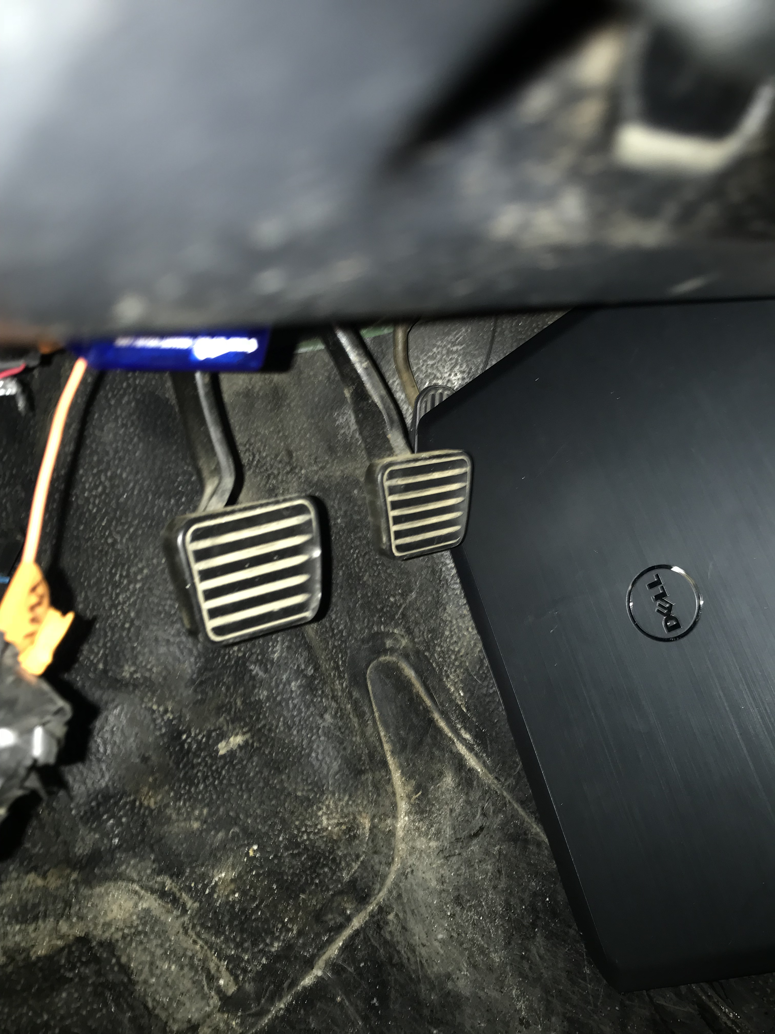
Last Resort
Still self driving but only stops on impact and NO control of steering. Wear a seatbelt….or two.
Technological due to the laptop pressing the accelerator instead of a brick.
Notes:
Alex
Merely a joke. Do not spend more than ten seconds on this slide. ”This is a last resort” give a couple seconds for people to see picture.. Ha..ha….then move on to questions.

Slide 12
Questions?

